Slide 1
Baseline and on-statin treatment lipoprotein(a) levels for prediction of cardiovascular events: Individual patient-data meta-analysis of statin outcome trials Slide deck The full text of the paper is available at http://www.thelancet.com/journals/lancet/article/PIIS0140-6736(18)31652-0/fulltext
Notes:
Vielen Dank für die freundliche Einführung. Es ist mir eine Freude, Ihnen heute meine Forschungsarbeit zu kardiometabolischen Erkrankungen, dem Herzinfarkt, Schlaganfall und Diabetes zu vorzustellen.

Slide 2
Rationale
Lipoprotein(a) is an established risk factor for cardiovascular disease (CVD) in the general population.
The relevance of lipoprotein(a) concentration to CVD risk in patients on statin therapy is uncertain because statin trials:
have yielded conflicting results and
were uniformly underpowered as they involved only a small number of patients with high concentration of lipoprotein(a).
To clarify this uncertainty, the Lipoprotein(a) Studies Collaboration analysed individual-level data on 29,069 patients involved in seven landmark statin trials.
Willeit et al. Lancet 2018.
http://dx.doi.org/10.1016/S0140-6736(18)31652-0
Notes:
In dieser Situation stellen sich nun drei Fragen, entsprechend welcher dieser Vortrag gegliedert sein wird:
Welche Auswirkung hat ein kardiometabolisches Ereignis auf die Lebenserwartung eines Menschen?
Gibt es andere Risikomarker – zusätzlich zu den klassischen Risikofaktoren – die mit kardiometabolisches Risiko zusammenhängen?
Gibt es Marker, die wir zusätzlich in der klinischen Routine messen sollten, um das Risiko einer Person besser einschätzen zu können?
Diese drei Fragen bilden die Grundstruktur meines Habilitationsvortages.

Slide 3
Design features of contributing trials
Trial | Years of baseline | Target population | Lipid entry criteria, mmol/L | Comparator to placebo | Outcome definition
 |  |  |  |  | MI | Stable angina | Stroke | Revascularisation | Other
AFCAPS | 1990-1993 | Primary prevention | TC 4·65-6·82, LDL-C 3·36-4·91, TG ≤4·52, HDL-C ≤1·16♂ and ≤1·22♀ | Lovastatin 20mg | ● | ● | ● | ● | ●*
CARDS | 1997-2001 | Type 2 diabetes | LDL-C ≤4·14, TG ≤6·78 | Atorvastatin 10mg | ● | ○ | ● | ● | ○
4D | 1998-2002 | Type 2 diabetes + hemodialysis | LDL-C 2·07-4·92, TG ≤11·3 | Atorvastatin 20mg | ● | ○ | ● | ● | ○
JUPITER | 2003-2006 | Primary prevention with C-reactive protein >2mg/dL | LDL-C <3·4, TG <5·65 | Rosuvastatin 20mg | ● | ○ | ● | ● | ●†
LIPID | 1990-1992 | Prior myocardial infarction or unstable angina | TC 4·0-7·0, TG <5·0 | Pravastatin 40mg | ● | ○ | ● | ● | ○
MIRACL | 1997-1999 | Acute coronary syndrome | TC <7·0 | Atorvastatin 80mg | ● | ○ | ● | ● | ○
4S | 1989-1990 | Prior myocardial infarction or angina | TC 5·5-8·0, TG ≤2·5 | Simvastatin 20mg | ● | ○ | ○ | ● | ○
*includes TIA, PVD, sudden death, and deaths from other cardiovascular causes. †Deaths from other cardiovascular causes.
Willeit et al. Lancet 2018.
http://dx.doi.org/10.1016/S0140-6736(18)31652-0
Notes:
Als erstes zeige ich Ihnen nun meine Ergebnisse bezüglich der Lebenserwartung bei kardioetabolischen Erkrankungen.

Slide 4
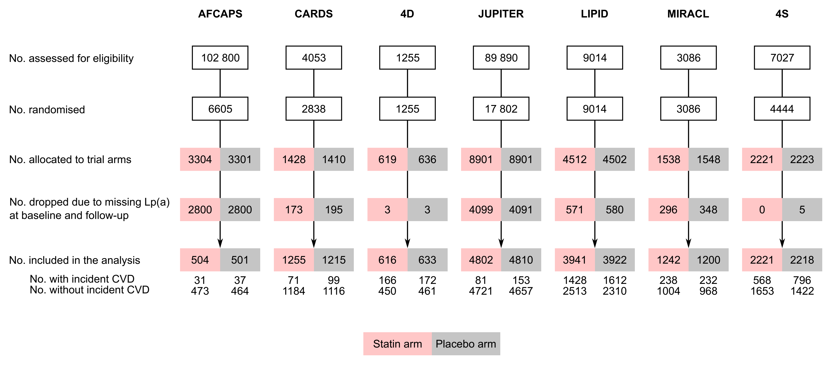
CONSORT diagram
Willeit et al. Lancet 2018.
http://dx.doi.org/10.1016/S0140-6736(18)31652-0

Slide 5
Patient characteristics – Baseline
 | AFCAPS | CARDS | 4D | JUPITER | LIPID | MIRACL | 4S | Total
Baseline
No. of patients | 1005 | 2470 | 1249 | 9612 | 7863 | 2431 | 4439 | 29069
Lp(a), mg/dL, median (IQR) | 7 (3-17) | 9 (5-22) | 12 (5-42) | 11 (5-23) | 14 (7-44) | 10 (5-29) | 10 (4-28) | 11 (5-29)
<15 mg/dL | 733 (73) | 1658 (67) | 709 (57) | 5896 (61) | 4118 (52) | 1481 (61) | 2654 (60) | 17249 (59)
15-<30 mg/dL | 134 (13) | 310 (13) | 129 (10) | 1867 (19) | 1147 (15) | 362 (15) | 781 (18) | 4730 (16)
30-<50 mg/dL | 84 (8) | 212 (9) | 140 (11) | 851 (9) | 877 (11) | 223 (9) | 714 (16) | 3101 (11)
≥50 mg/dL | 54 (5) | 290 (12) | 271 (22) | 998 (10) | 1721 (22) | 365 (15) | 290 (7) | 3989 (14)
Age, yrs | 59 (7) | 62 (8) | 66 (8) | 66 (8) | 61 (8) | 65 (11) | 59 (7) | 62 (8)
Female sex | 173 (17) | 779 (32) | 576 (46) | 3556 (37) | 1333 (17) | 820 (34) | 827 (19) | 8064 (28)
Prior CVD | 0 (0) | 6 (0) | 513 (41) | 0 (0) | 7863 (100) | 2431 (100) | 4439 (100) | 15252 (52)
Diabetes | 32 (3) | 2470 (100) | 1249 (100) | 0 (0) | 676 (9) | 548 (23) | 202 (5) | 5177 (18)
Current smoking | 130 (13) | 551 (22) | 108 (9) | 1492 (16) | 735 (9) | 693 (29) | 1138 (26) | 4847 (17)
SBP, mmHg | 136 (17) | 144 (16) | 146 (22) | 136 (17) | 134 (19) | 128 (20) | 139 (20) | 137 (18)
LDL-C_{corr}, mmol/L | – | 2·75 (0·78) | 3·00 (0·86) | 2·57 (0·49) | 3·68 (0·74) | 3·04 (0·86) | 4·74 (0·66) | 3·30 (0·67)
HDL-C, mmol/L | – | 1·64 (0·50) | 0·94 (0·34) | 1·35 (0·40) | 0·96 (0·24) | 1·20 (0·31) | 1·19 (0·30) | 1·21 (0·35)
BMI, kg/m² | 26 (3) | 29 (4) | 28 (5) | 29 (6) | – | 28 (5) | 26 (3) | 28 (5)
eGFR, mL/min | – | – | – | 75 (17) | 71 (17) | – | – | 73 (17)
Apo-B, g/L | – | 1·16 (0·24) | 1·10 (0·30) | 1·08 (0·21) | 1·33 (0·25) | – | 1·16 (0·18) | 1·17 (0·23)
Willeit et al. Lancet 2018.
http://dx.doi.org/10.1016/S0140-6736(18)31652-0
Notes:
Als erstes zeige ich Ihnen nun meine Ergebnisse bezüglich der Lebenserwartung bei kardioetabolischen Erkrankungen.

Slide 6
Patient characteristics – Follow-up
 | AFCAPS | CARDS | 4D | JUPITER | LIPID | MIRACL | 4S | Total
On-statin
No. of patients | 504 | 1255 | 616 | 4802 | 3941 | 1200 | 2218 | 14536
Time to Lp(a) repeat, yrs, median | 1·0 | 2·5 | 0·5 | 1·0 | 1·0 | 0·2 | 2·5 | 1·0
Lp(a), mg/dL, median (IQR) | 7 (3-19) | 8 (4-22) | 11 (5-40) | 11 (4-25) | 13 (6-43) | 11 (5-33) | 11 (4-33) | 11 (5-32)
<15 mg/dL | 366 (73) | 864 (69) | 351 (57) | 2912 (61) | 2106 (53) | 707 (59) | 1268 (57) | 8574 (59)
15-<30 mg/dL | 59 (12) | 134 (11) | 60 (10) | 868 (18) | 548 (14) | 175 (15) | 321 (15) | 2165 (15)
30-<50 mg/dL | 43 (9) | 103 (8) | 73 (12) | 417 (9) | 439 (11) | 96 (8) | 375 (17) | 1546 (11)
≥50 mg/dL | 36 (7) | 154 (12) | 132 (21) | 605 (13) | 848 (22) | 222 (19) | 254 (12) | 2251 (15)
% change vs. baseline (95% CI) | -1% (-6, 4) | -13% (-15, -10) | -6% (-9, -3) | 2% (1, 3) | -7% (-8, -5) | 9% (6, 12) | 15% (13, 17) | -0·4% (-7, 7)
LDL-C_{corr}, mmol/L | – | 1·68 (0·58) | 1·73 (0·78) | 1·43 (0·70) | 2·57 (0·71) | 1·56 (0·77) | 2·97 (0·70) | 1·99 (0·70)
% change vs. baseline (95% CI) | – | -37% (-38, -36) | -41% (-43, -39) | -43% (-44, -42) | -29% (-30, -29) | -47% (-49, -46) | -37% (-37, -36) | -39% (-43, -35)
CVD incidence
Follow-up, yrs, median (IQR) | 5·6 (4·8-6·2) | 4·1 (3·1-4·8) | 2·4 (1·4-3·7) | 2·0 (1·5-2·4) | 5·4 (3·1-6·0) | 0·3 (0·3-0·3) | 5·3 (3·9-5·5) | 3·0 (1·5-5·3)
No. of events, overall | 68 | 170 | 338 | 234 | 3040 | 537 | 1364 | 5751
No. of events, statin arm | 31 | 71 | 166 | 81 | 1428 | 258 | 568 | 2603
Willeit et al. Lancet 2018.
http://dx.doi.org/10.1016/S0140-6736(18)31652-0
Notes:
Als erstes zeige ich Ihnen nun meine Ergebnisse bezüglich der Lebenserwartung bei kardioetabolischen Erkrankungen.

Slide 7
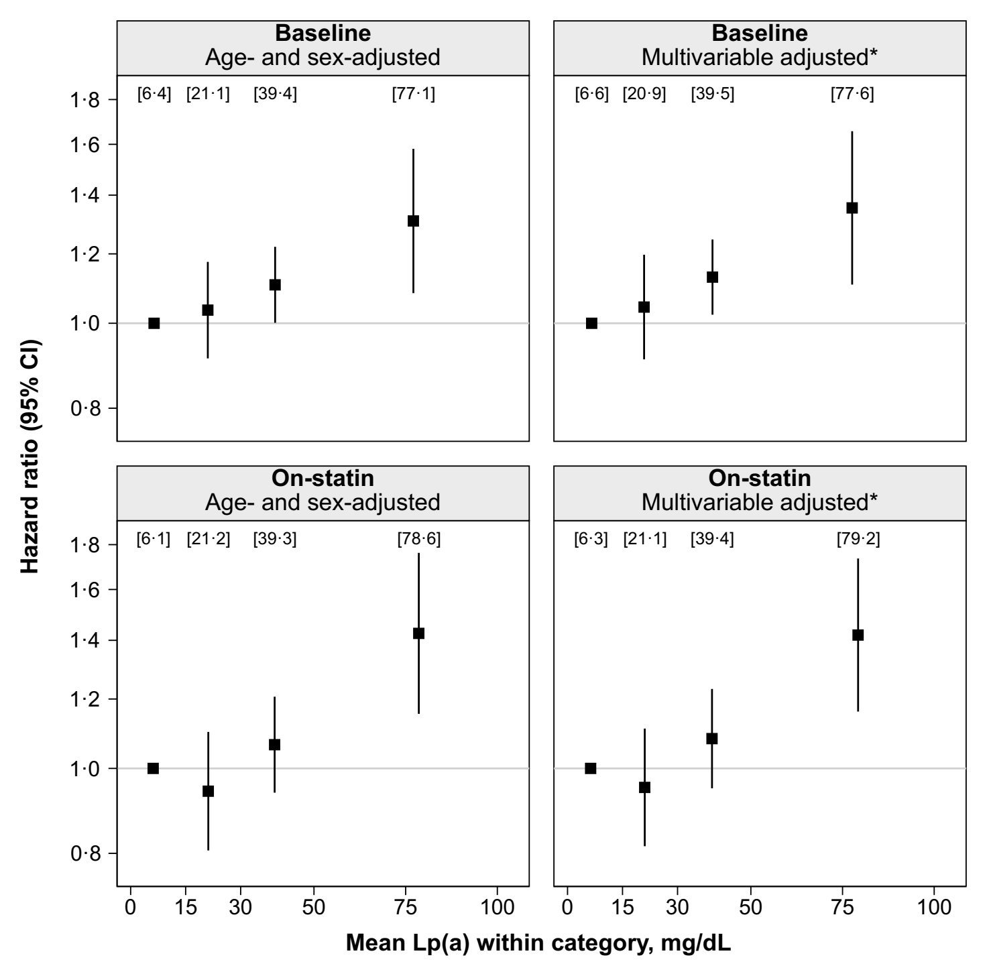
Association of Lipoprotein(a) with CVD risk
Comparison of groups with lipoprotein(a) levels of
<15 mg/dL,
15 to <30 mg/dL,
30 to <50 mg/dL, and
≥50 mg/dL.
Multivariable adjustment included age, sex, previous CVD, diabetes, smoking, systolic blood pressure, LDL cholesterol corrected for lipoprotein(a) cholesterol, and HDL cholesterol.
Associations were independent of established risk factors.
Willeit et al. Lancet 2018.
http://dx.doi.org/10.1016/S0140-6736(18)31652-0

Slide 8
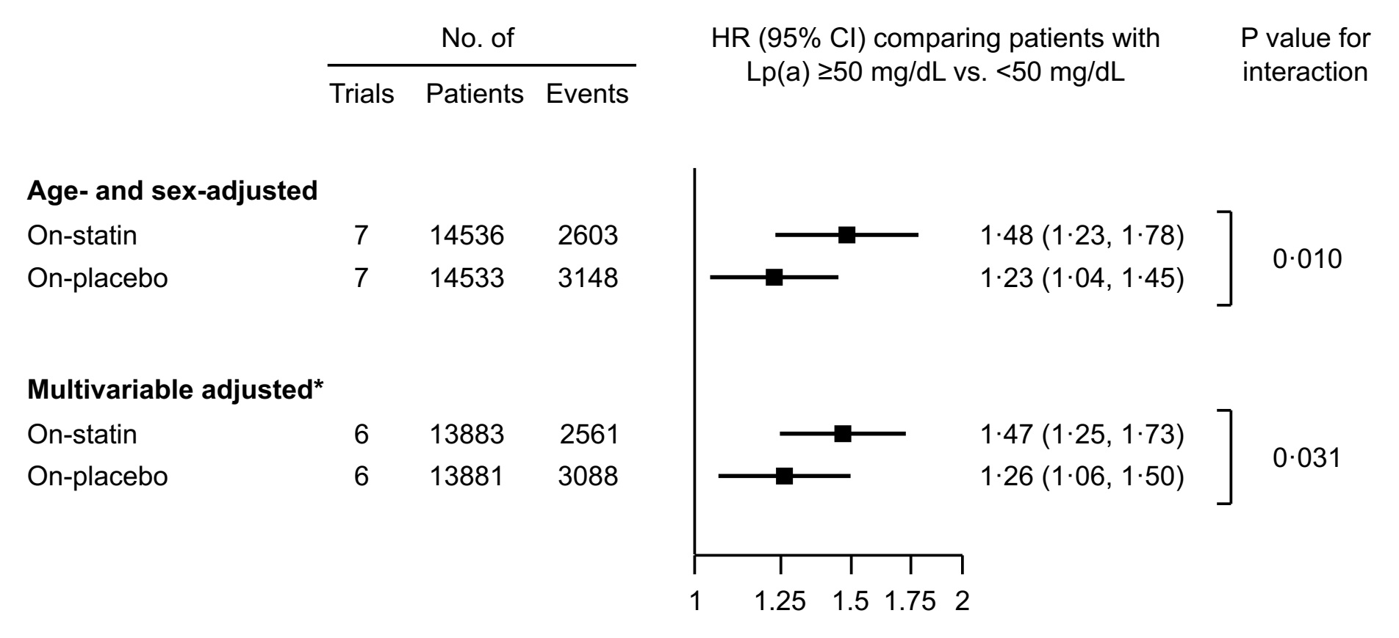
Predictive value of on-statin vs. on-placebo lipoprotein(a) concentration
In an interaction analysis, the association of high lipoprotein(a) with CVD risk was stronger in patients allocated a statin than in patients allocated placebo.
Willeit et al. Lancet 2018.
http://dx.doi.org/10.1016/S0140-6736(18)31652-0

Slide 9
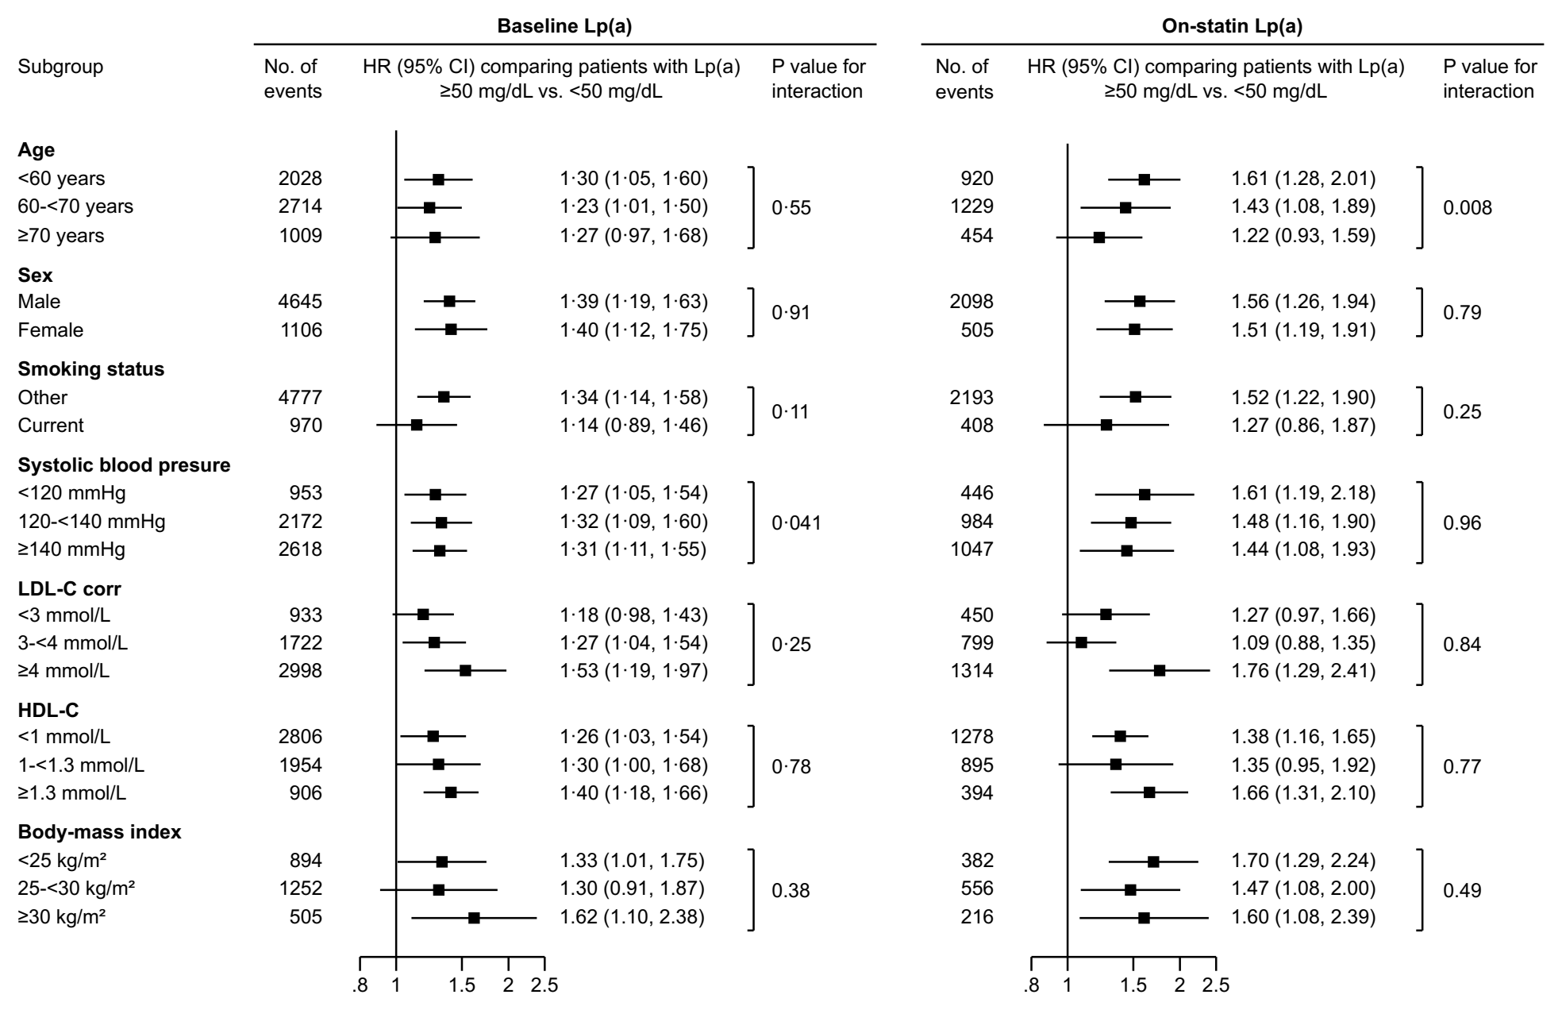
Predictive value according to clinically important patient characteristics
Willeit et al. Lancet 2018.
http://dx.doi.org/10.1016/S0140-6736(18)31652-0

Slide 10
Conclusion
This meta-analysis demonstrates an approximately linear relationship of cardiovascular risk to levels of Lp(a), evident at Lp(a) levels 30-50 mg/dL, pronounced at levels ≥50 mg/dL, and persisting despite statin treatment.
The data provide a rationale for evaluating drugs that can specifically lower Lp(a) and might have the potential to reduce residual cardiovascular risk independent of statin treatment.
How to join the Lipoprotein(a) Studies Collaboration
To contribute lipoprotein(a) data from your prospective cohort study or clinical trial, please get in touch with the coordinating centre via https://clinicalepi.i-med.ac.at/research/lpasc/
Willeit et al. Lancet 2018.
http://dx.doi.org/10.1016/S0140-6736(18)31652-0

